Slide 1
SOAP to Webservice Synchronous for fetching Weather Report
Mumbai , 27/08/2019, Utkarsh Awasthi

Slide 2
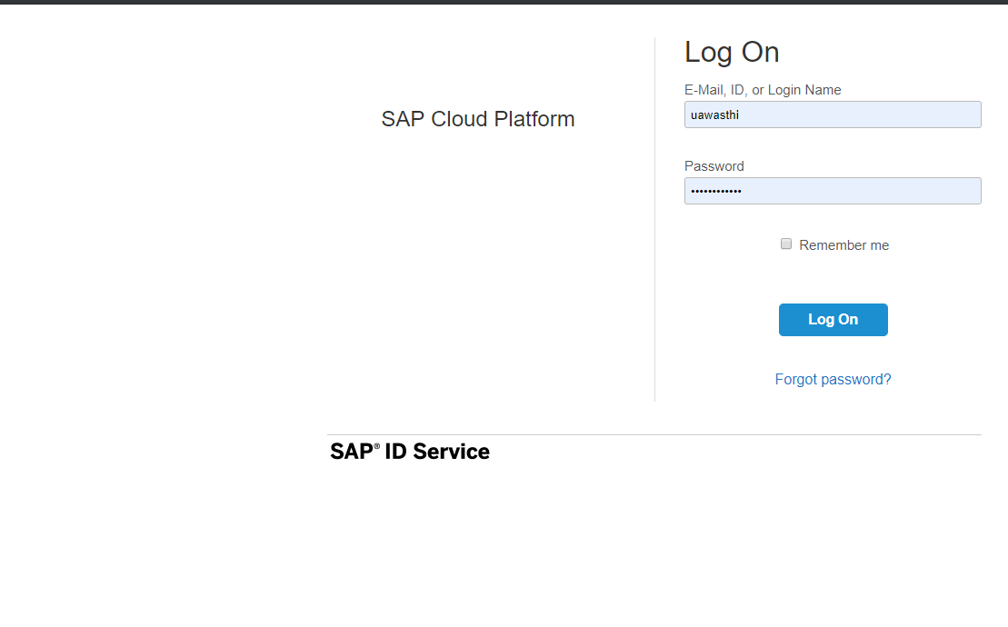
Access to the CPI Tools
Link Provided:
https://accounts.sap.com/saml2/idp/sso/accounts.sap.com

Slide 3
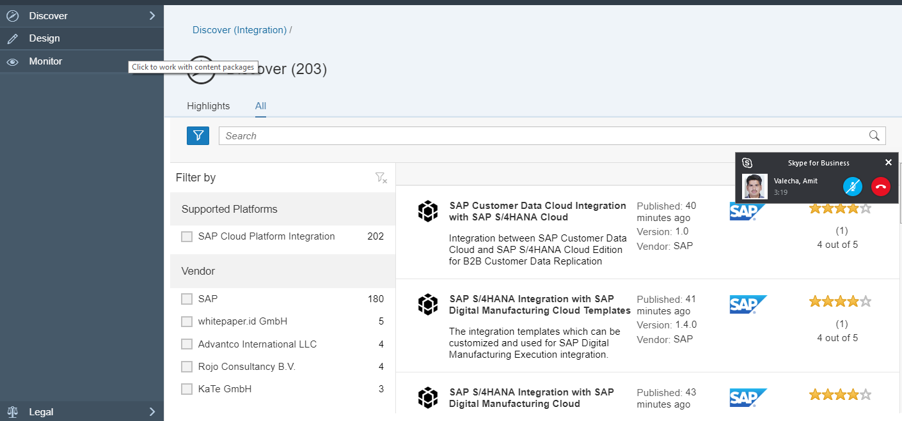
Click to Design to Work with Content Packages

Slide 4
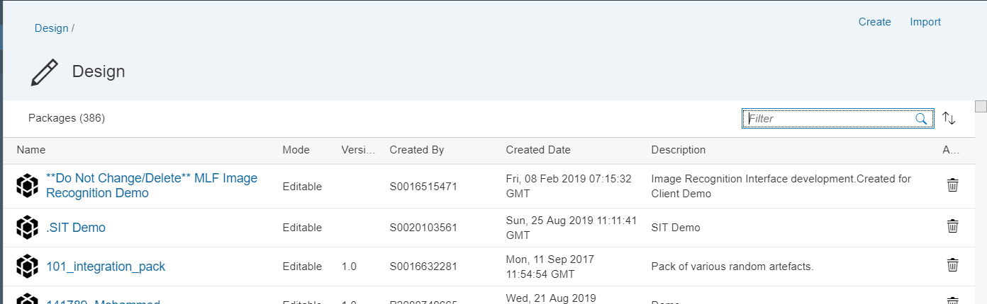
Click to Create to Create your own Package and Save it:

Slide 5
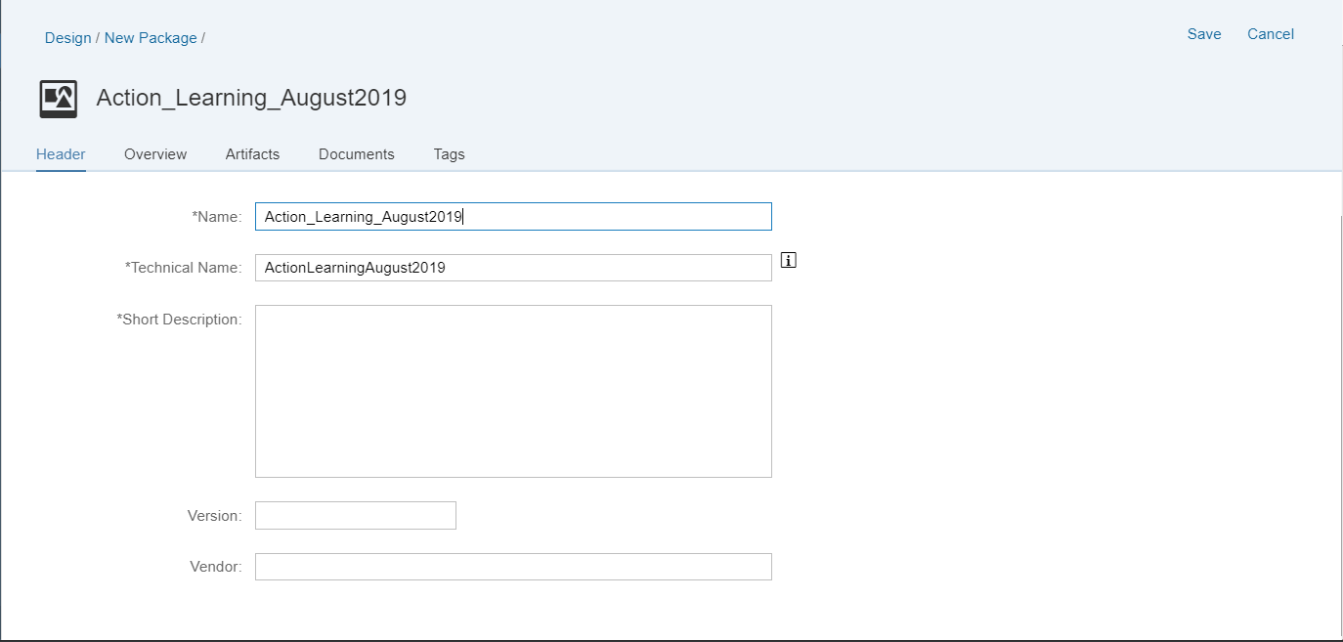

Slide 6
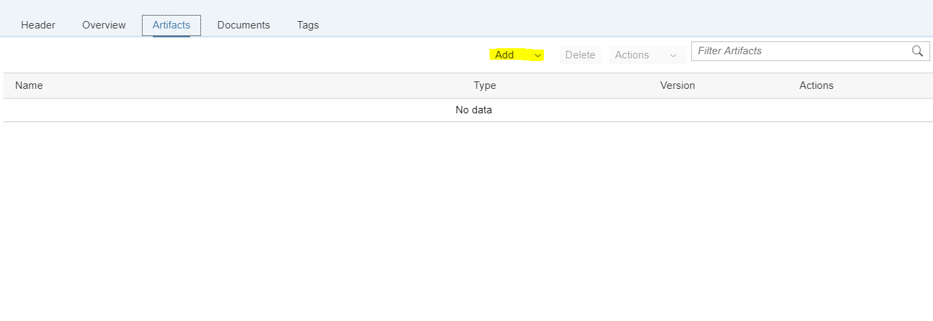
1 . Create an Iflow inside the Package from Artifact Tab :

Slide 7
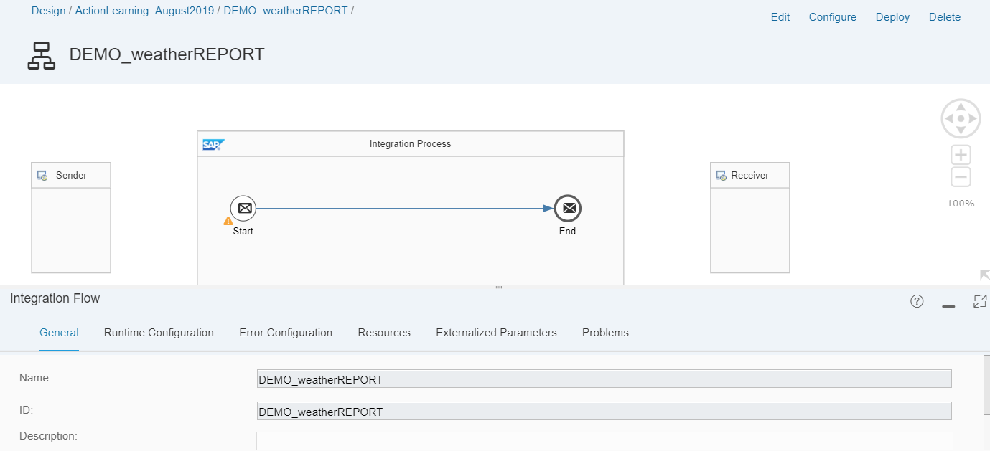
Create one sender participant and one receiver participant.
Connect the sender participant and Integration process using SOAP Adapter.

Slide 8
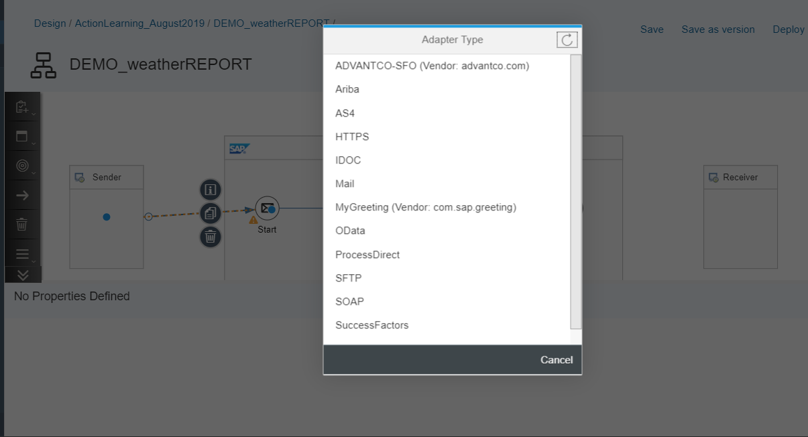
2.Create one sender participant and one receiver participant.
3.Connect the sender participant and Integration process using SOAP Adapter.

Slide 9
4. Connect the sender participant and Integration process using SOAP Adapter.
5.Maintain the Message exchange pattern as Request-Reply
6.Use the pallet function Request reply and connect the Receiver participant with SOAP Receiver adapter.

Slide 10
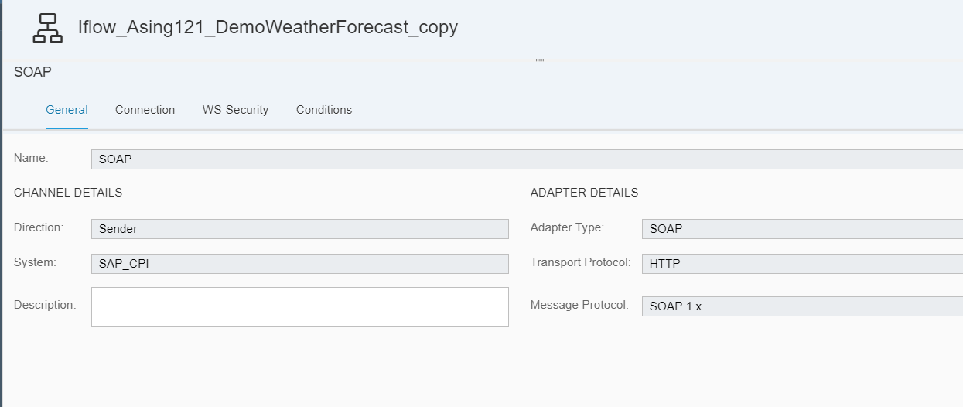

Slide 11
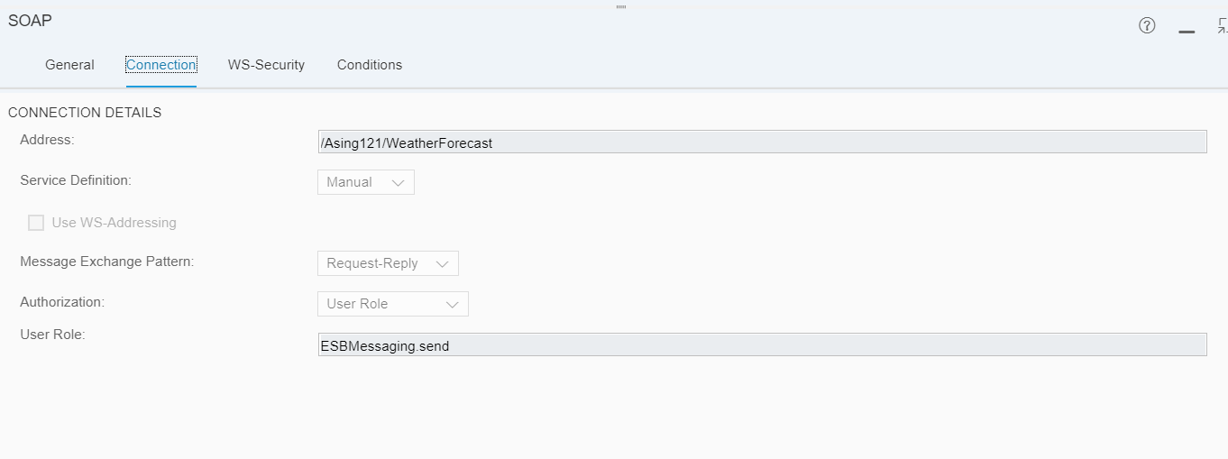

Slide 12
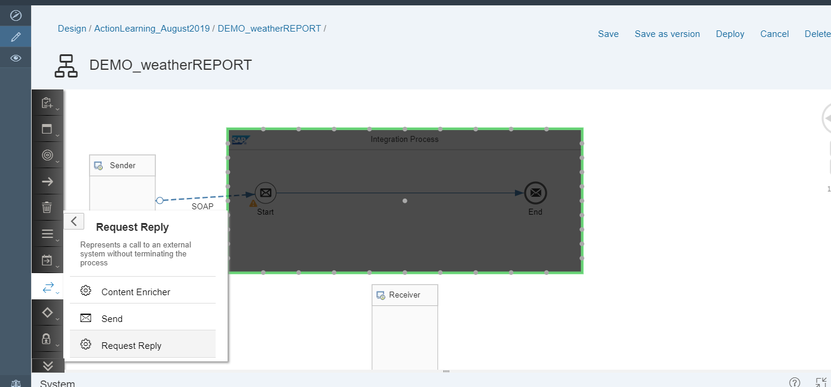

Slide 14
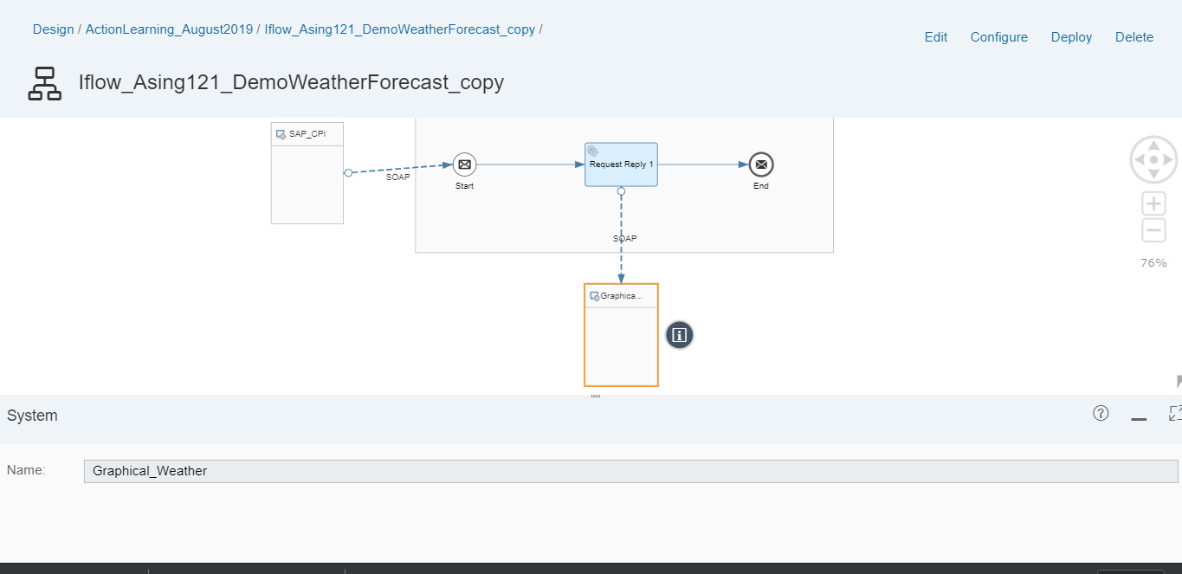
Configure the SOAP Receiver Adapter with the below URL
https://graphical.weather.gov/xml/SOAP_server/ndfdXMLserver.php

Slide 15
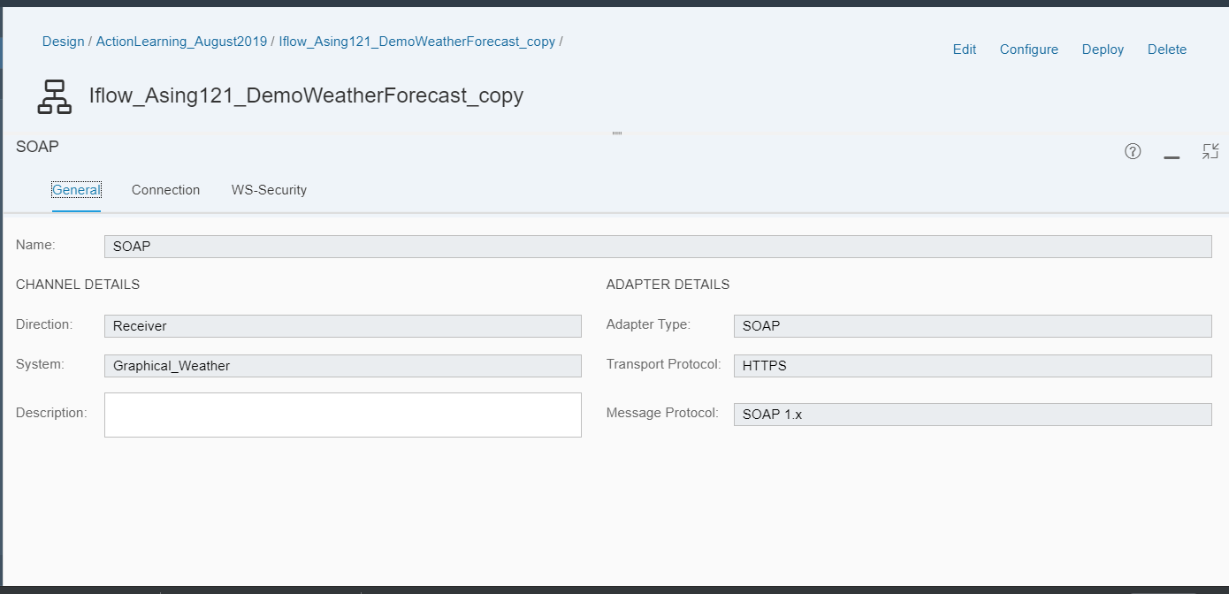

Slide 16
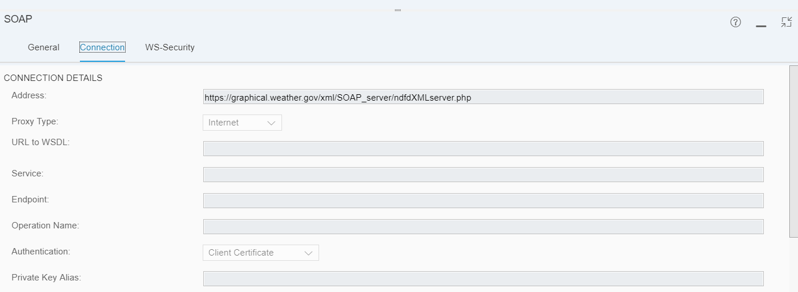

Slide 17
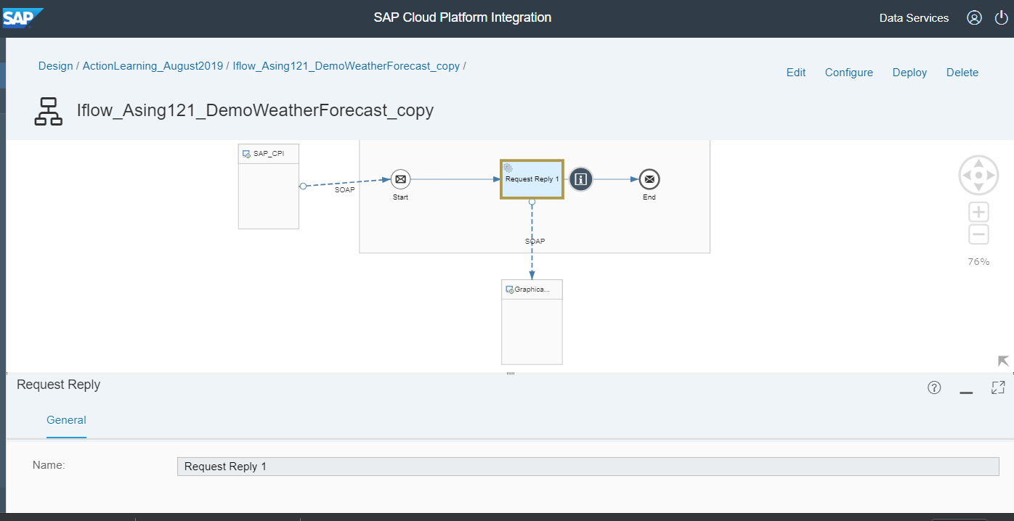
Connect the Request-Reply to the end. Save and Deploy the Iflow

Slide 18
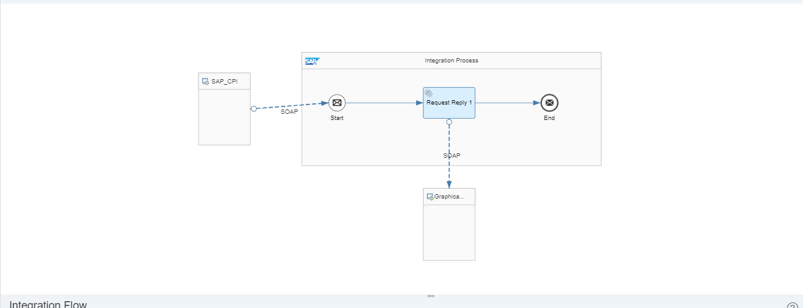

Slide 19
Use the below payload and push the request from SOAP UI and get the response for the corresponding location.
<ndf:NDFDgenByDay xmlns:ndf="https://graphical.weat her.gov/xml/DWMLgen/wsdl/ndfd XML.wsdl">
<latitude>35.4</latitude>
<longitude>-97.6</longitude>
<startDate/>
<numDays>1</numDays>
<Unit>m</Unit>
<format>24 hourly</format>
</ndf:NDFDgenByDay>

Slide 21
SAP Exchange Infrastructure
Introduction
Application Environment
Hands On
Help Me
Demonstration

